Slide 1


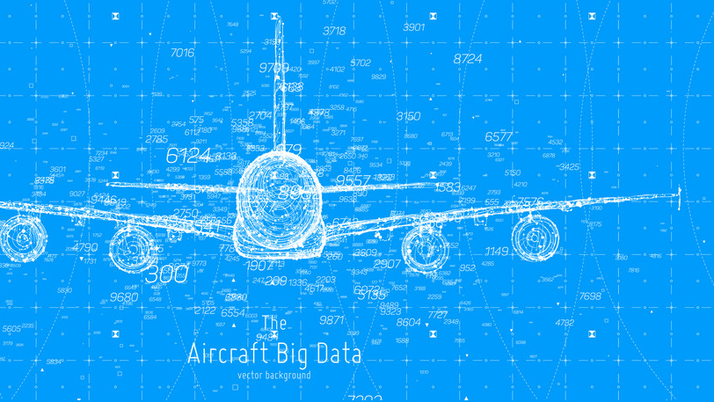
USA Flight data
Project Big Data, Business Intelligence and NoSQL
By
Ishan Ameel
Jonas Anseel
Thomas Billiet
Sven Depickere

Slide 2


Cleanup

Slide 3
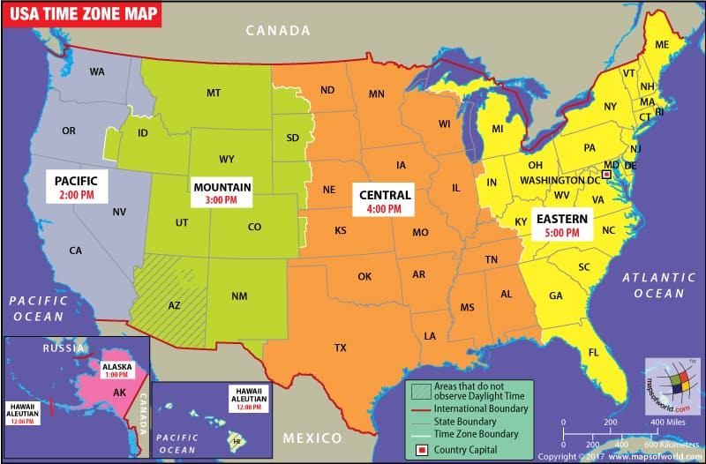
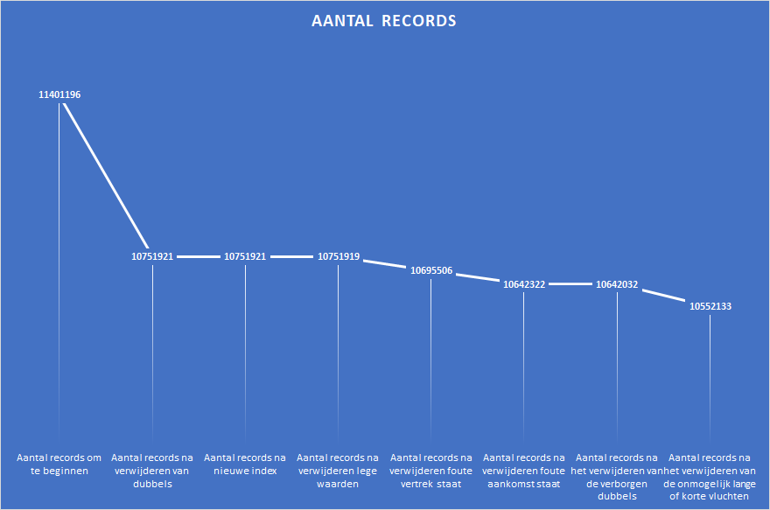

Slide 4

Charts

Slide 5

Machine learning

Slide 6

NetworkX

